Slide 1
Lecture 5-extra: Menu Examples from 2019 Class
Brad Myers
05-440/640: Interaction Techniques
Spring, 2022

Slide 2
Menu Examples
These are from HW 2 from the previous version of the class
Contributed by students
Can’t show their names ☹
Assignment 2 includes requirement to help update this list!

Slide 3
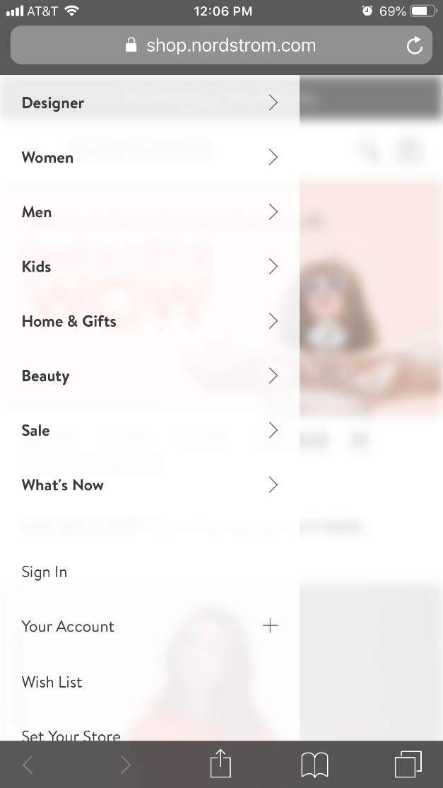
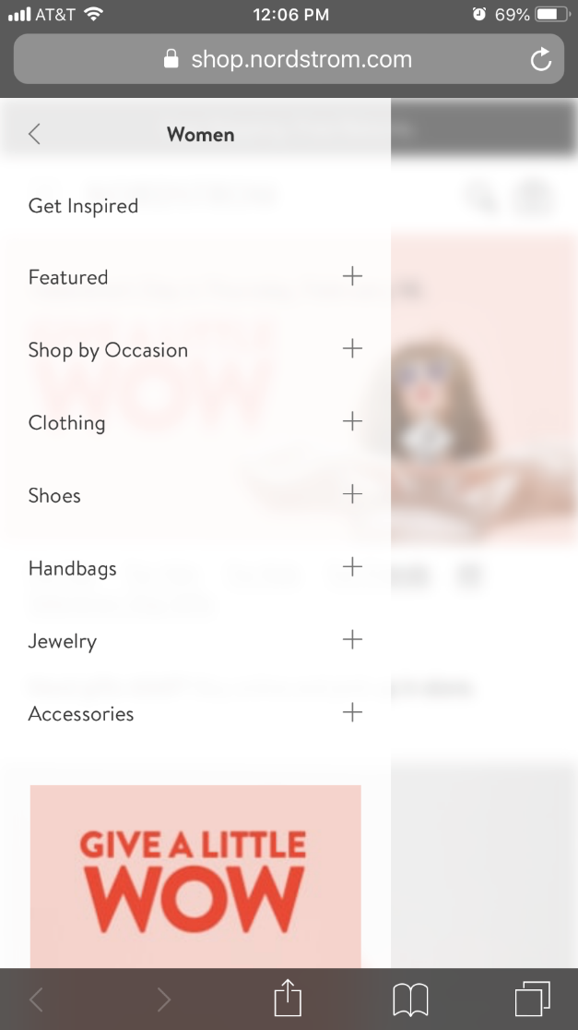
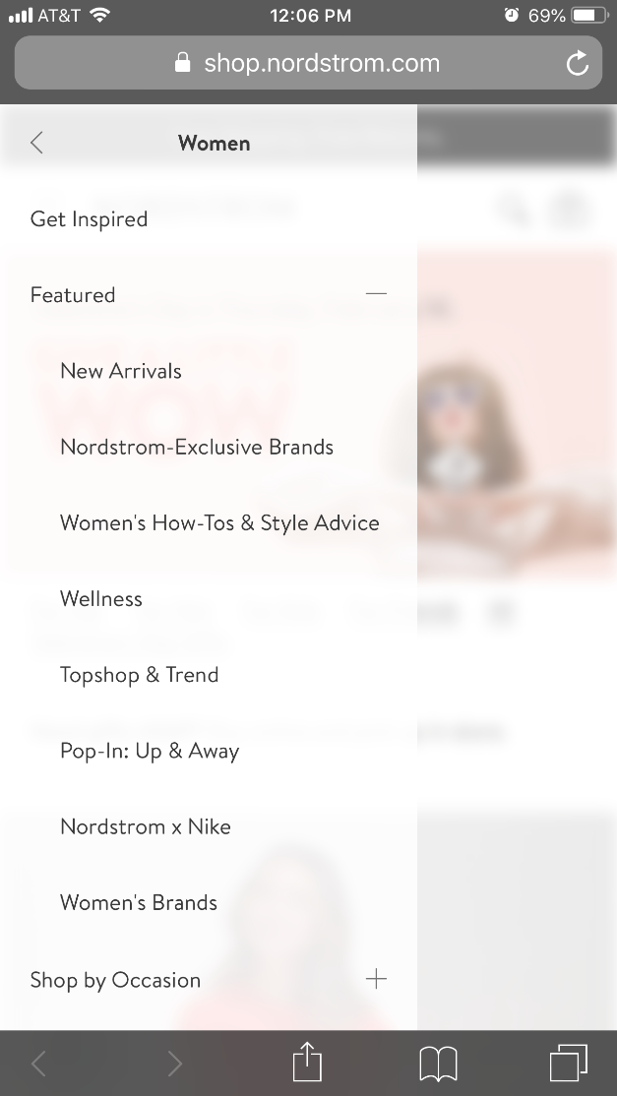
Nordstrom website – accordion menus (+/-)

Slide 4
VR menu
I thought this VR menu that can be activated in whichever the direction the user is viewing by pressing on a control button is interesting. Also the interaction with the app icons on the menu using a laser cursor to hover and drag seems interesting. The cursor disappears when dragging the app icon to indicate that the app icon is attached to the laser.

Slide 5
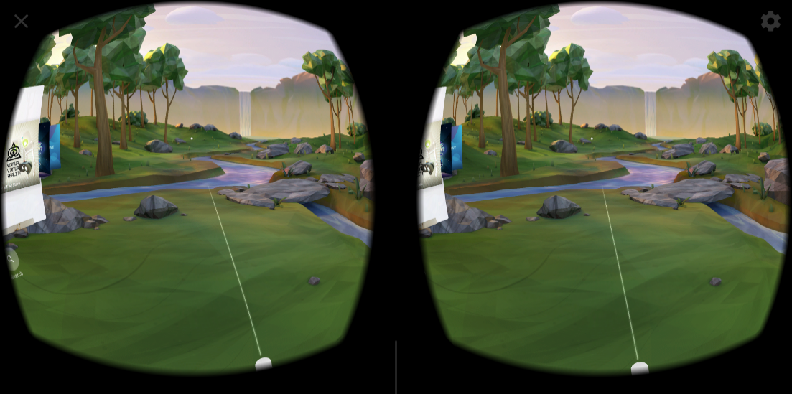
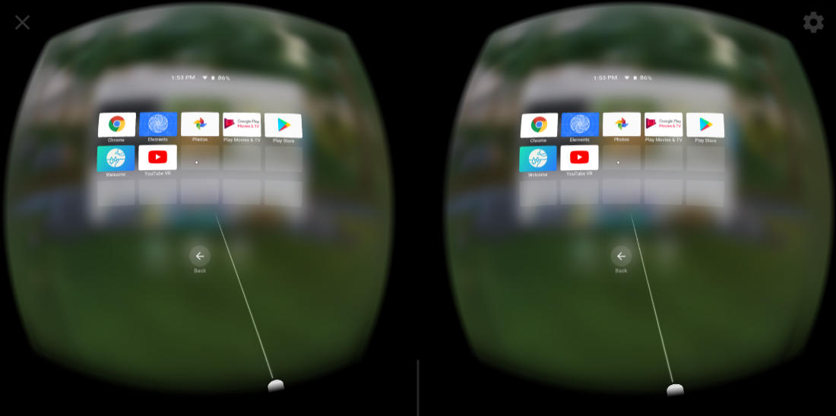
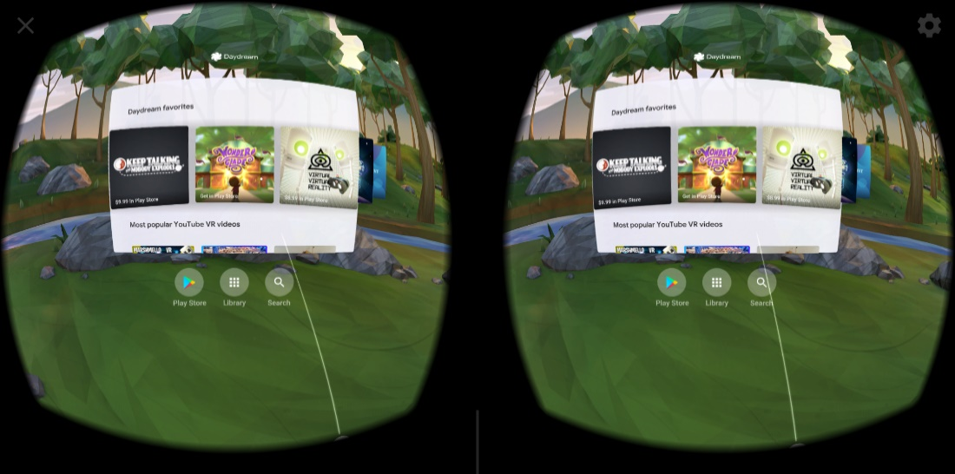
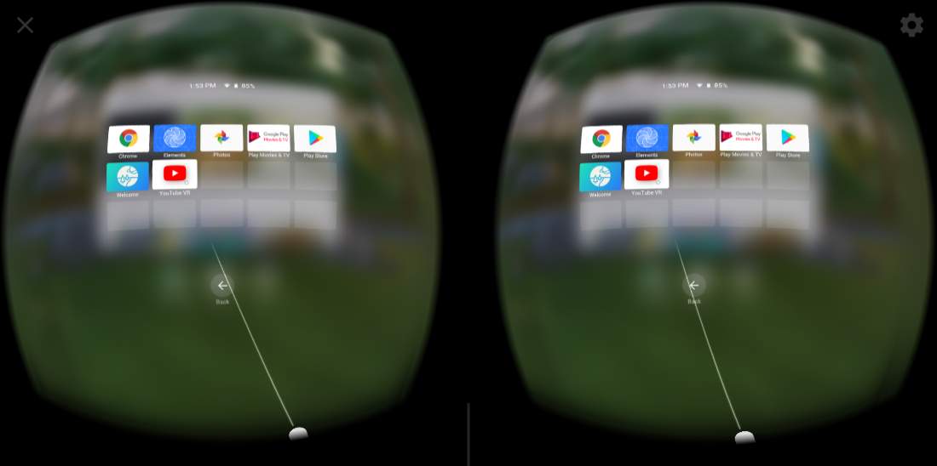
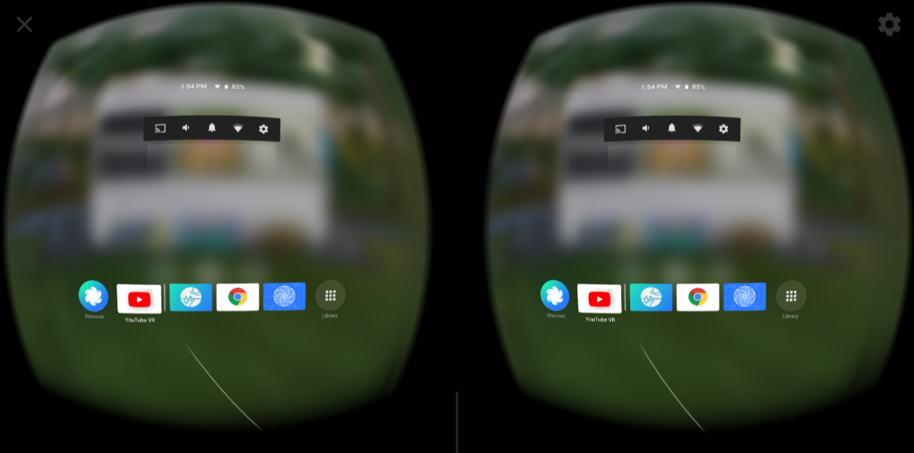

Slide 6
Pie menu in game
Grand Theft Auto 5 on PC with Mouse
Here is an interesting menu I found in a video game. Basically it’s function is to let the user choose the weapon of current player. The user press the tab button on the keyboard to call this menu. After that, a pie menu with 8 part pop up on the screen, each of them represent one kind of weapon. There is no cursor on the screen, the user could move the mouse to the direction relative to the middle of the circle to choose the weapon.

Slide 7
Grand Theft Auto 5 – Pie menu

Slide 8
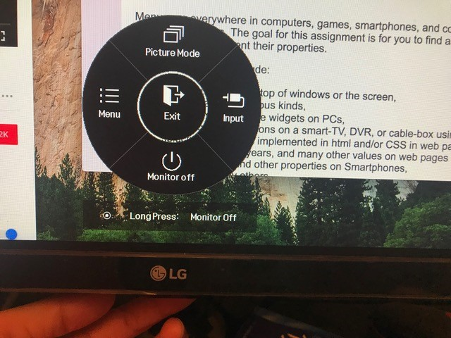
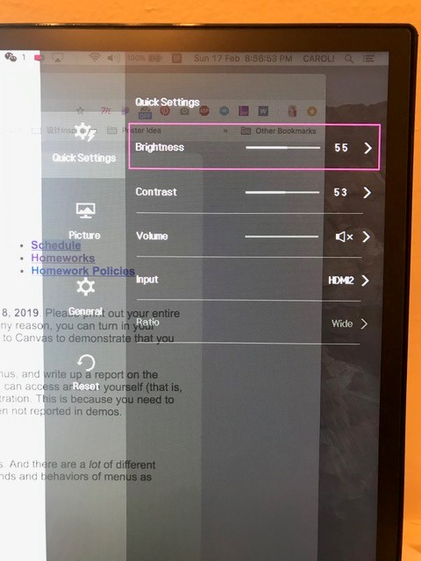
LG Monitor control menu
This is a LG monitor control menu, what is special is that it can only be controlled by pressing the button at the bottom of monitor, and pushing the button to different direction to select.

Slide 9
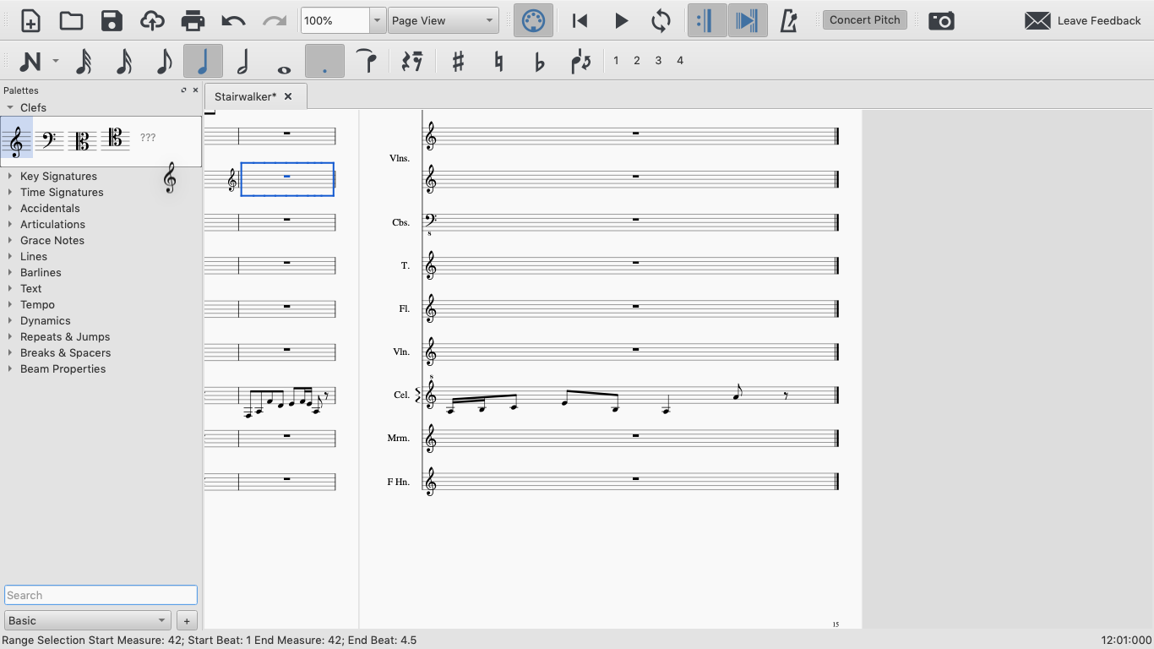
MuseScore3

Slide 10
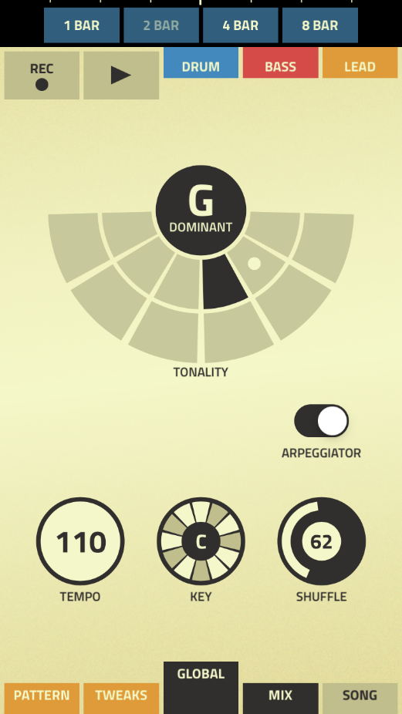
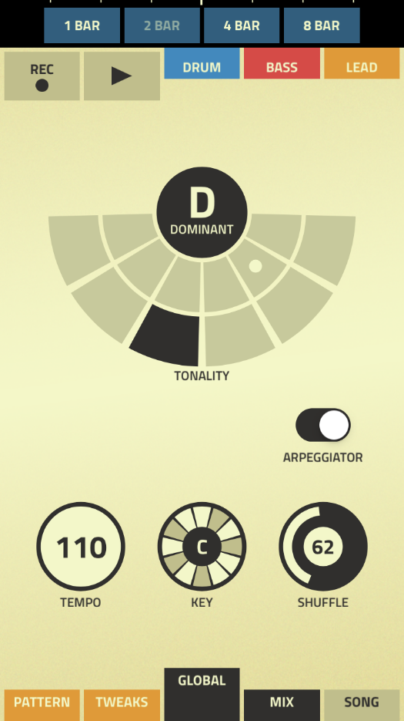
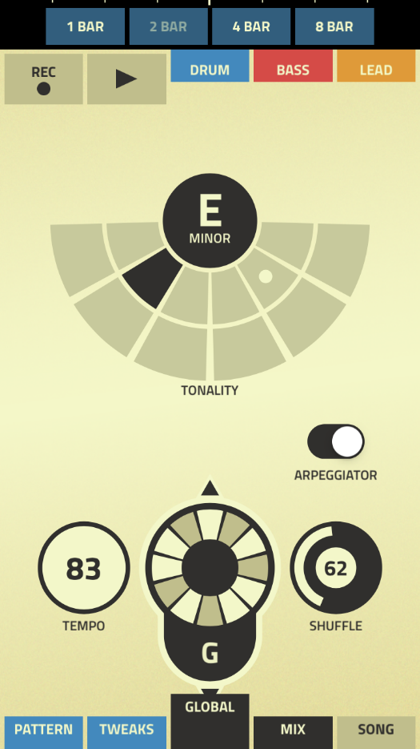
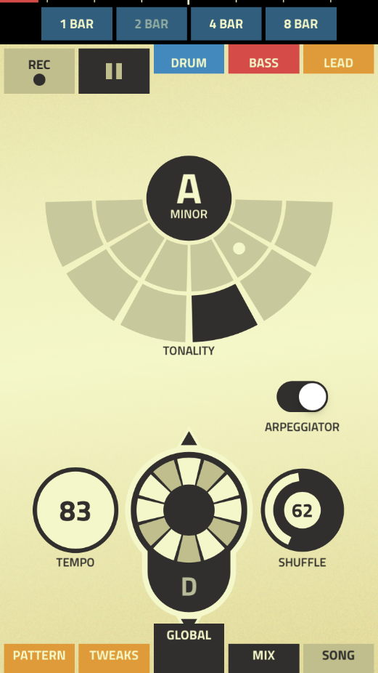
Figure by Propellerhead for iOS
Half pie menus

